Slide 1

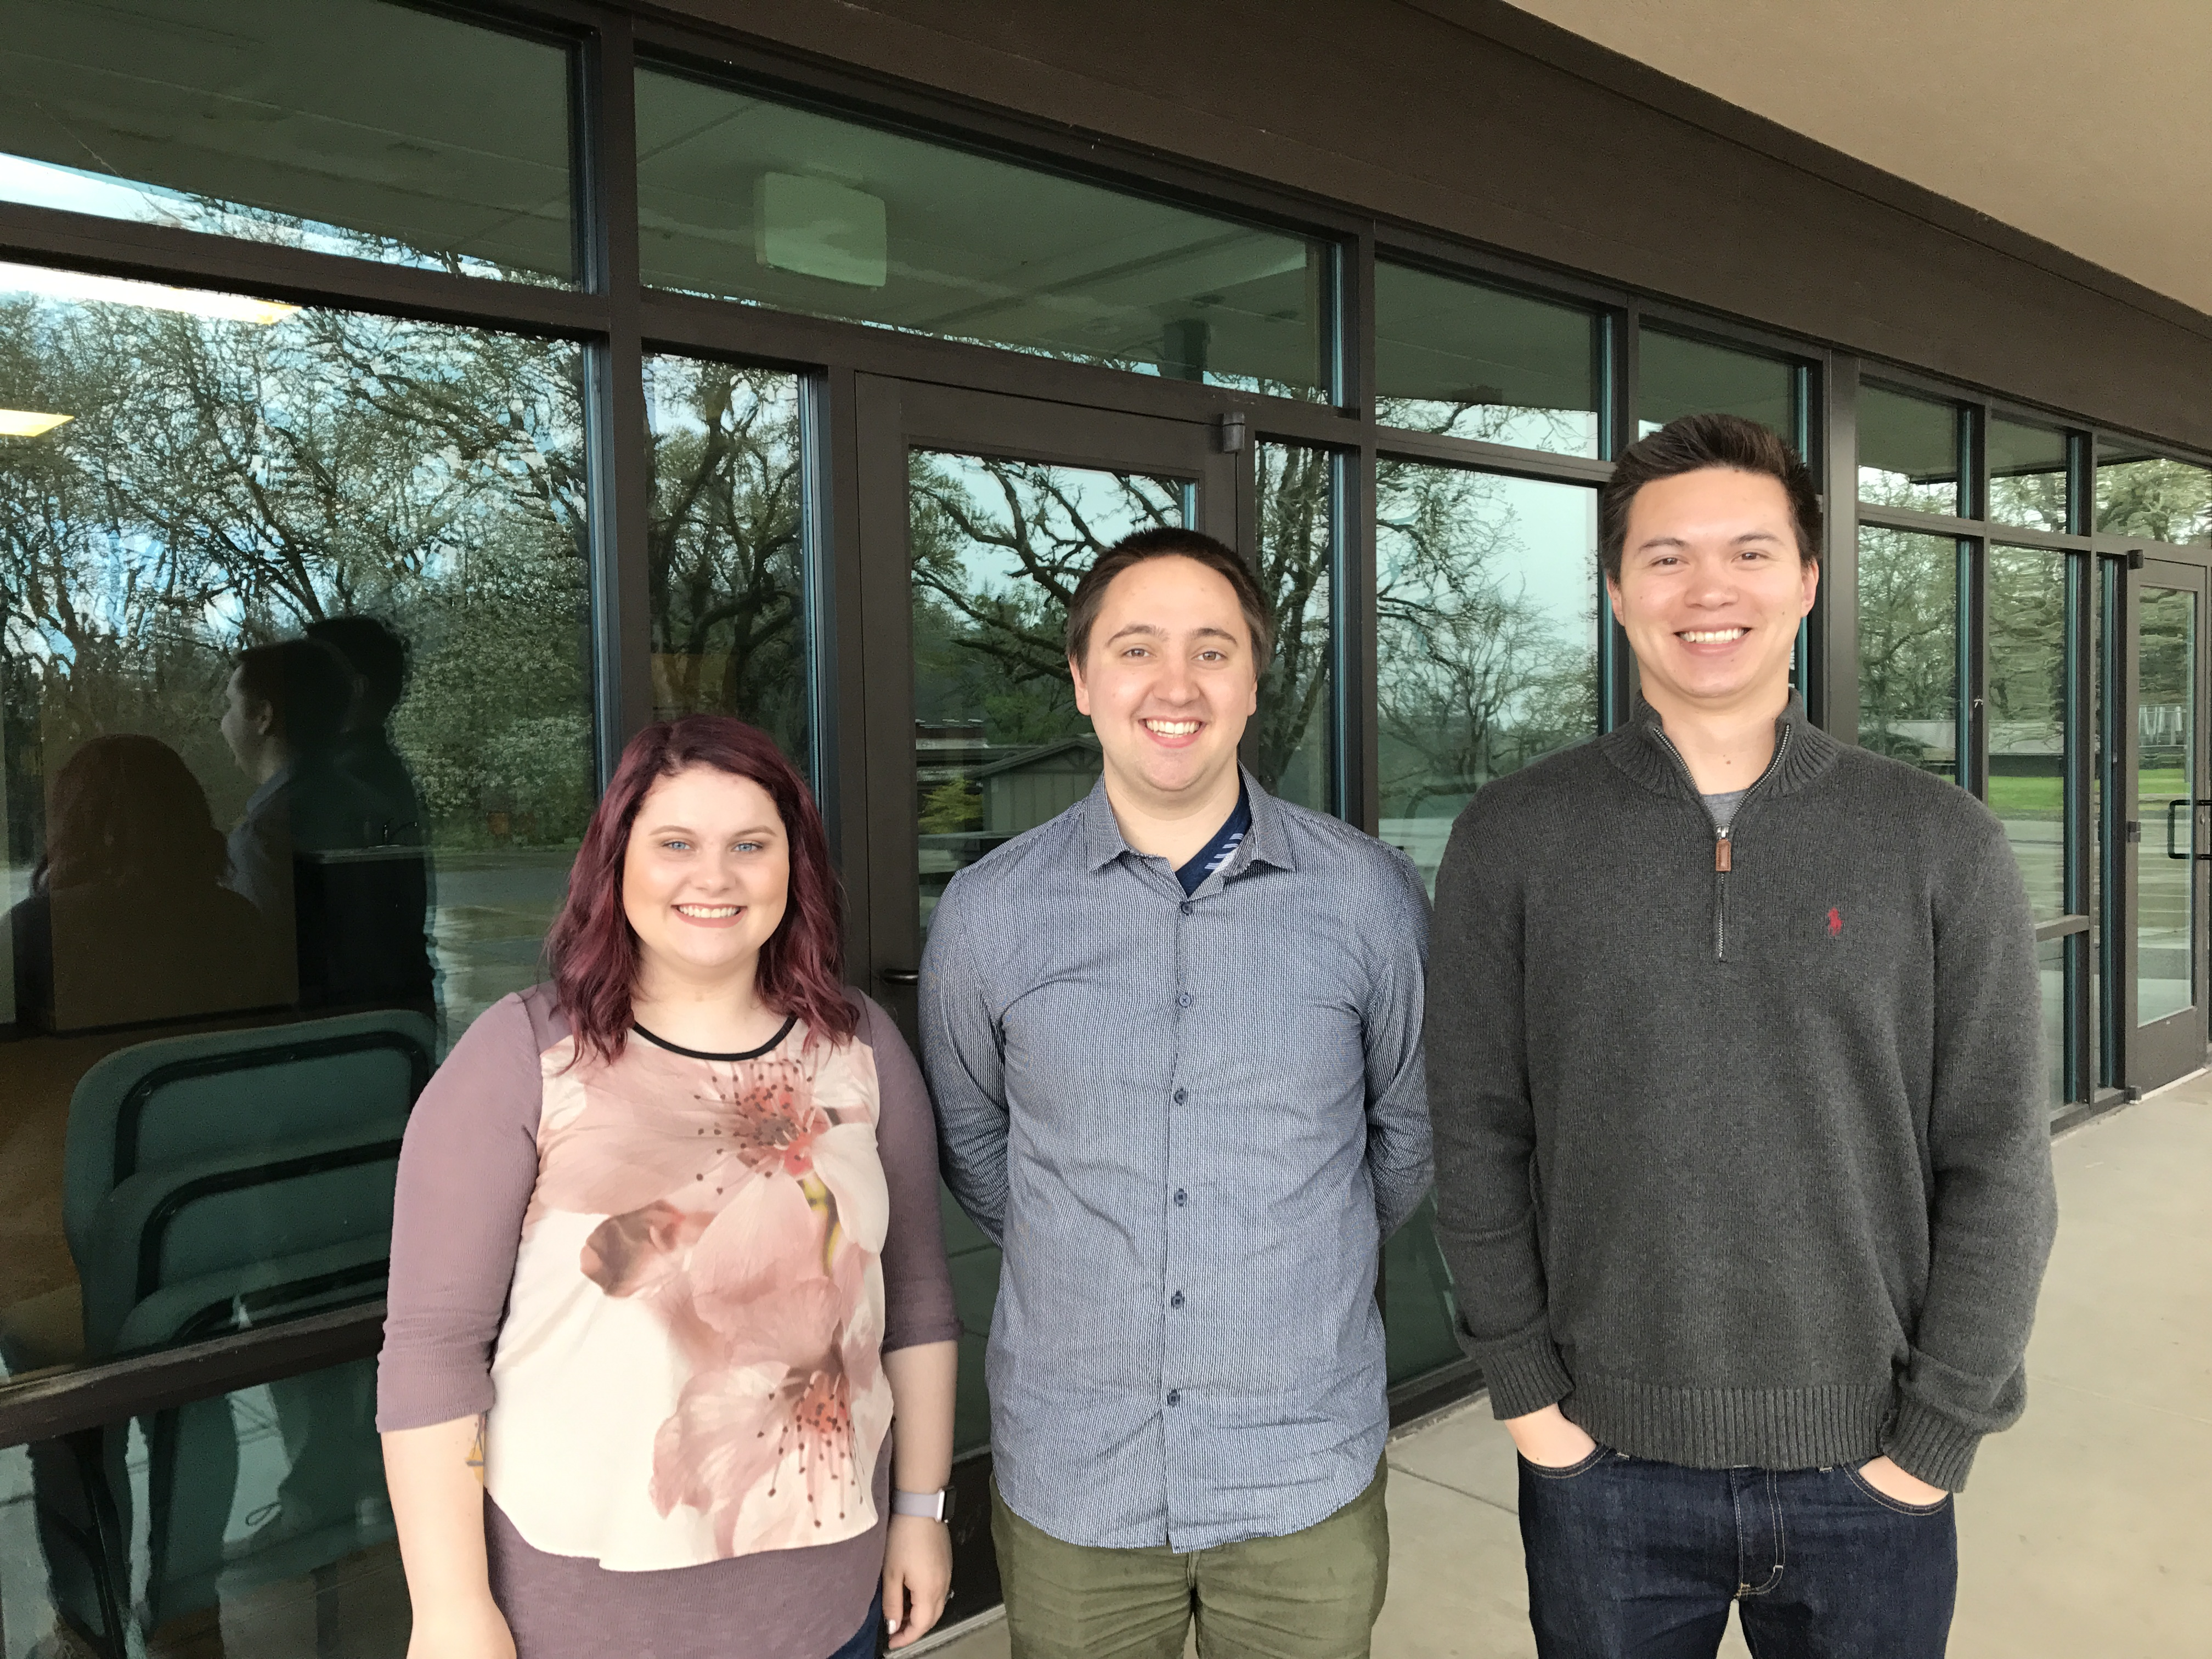
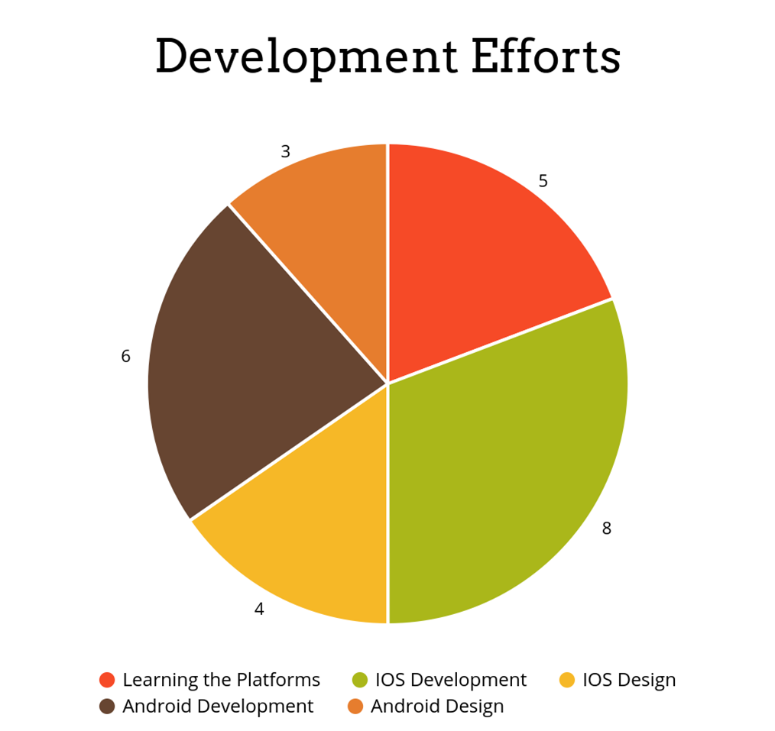
Calvary Chapel Corvallis
What Was the Problem?
Meet the Team and Our Client
WEBSITE BUT NO APP
Purpose: Produce an iOS/Android application for Calvary Chapel of Corvallis.
Current website does not provide an interface where current members of the church can very quickly access important information such as events, bulletins, and messages from the service.
The issue is that the church believes that people do not have the time or the knowledge to open up the website to access the information they need.
Printing out the bulletins every week to hand out at services can be expensive and ineffective.
The desired application will be simple enough for anyone to use while providing back end access for staff to easily upload new information to the app.
The priorities lie in maximizing the usability of the app and providing bulletin, schedule, video, and donation.
OUR SOLUTION
To create an iOS/Android app that will provide the most pertinent information for the churches core of membership.
Application will include an E-bulletin, the church schedule, the ability to watch past sermons, and the ability to donate.
The end goal is a highly usable product that even the least tech savvy individuals will be able to easily navigate.
Incorporate data from the churches database/website for minimal outside maintenance.
Helping Calvary Chapel connect their congregation
Computer Science Capstone Project
SOLUTION IMPLEMENTED
Two native applications for both iOS and Android
The pages on each application pull information directly from the corresponding website page
Bulletin: the Bulletin page on the website is sent through a JSON parser and the response is displayed on the app through a WebView. Using a WebView allowed us to use CSS styling to format the JSON response similarly to how the website is styled. This creates consistency between the website and the apps.
Donation: the donation page is loaded through a WebView. This decision was made in order to protect the security of any person using the app. The app will load the existing donation page from the website and will take advantage of the security measures already in place so that members can feel confident providing their credit card information.
Messages: The messages page loads a mini video player using a windowed WebView and using Livestream's live embed link. Buttons for past sermons links to a webpage listing all the pervious sermons for the user to search from. The Live video will auto play the most recent or any live services.
Events: The events page uses a URL connection to interface with the CCB public calendar API. The connection returns an XML file which is then parsed through to return any pertinent information such as event name, date, time, etc. The parsed data is then passed to the various corresponding labels to display that information to the user.
THE TEAM
Courtney Bonn: bonnc@oregonstate.edu
Maxwell Dimm: dimmm@oregonstate.edu
Kevin Stine: stinek@oregonstate.edu
OUR CLIENT
Desiree Gorham: Administrative Assistant
Ryan Smith: Social media/Design interface
Reuben Wai: A/V Media Interface
Ryan Gardner: Calvary Website Interface
Calvary Corvallis started at a small church in 1995, led by Senior Pastor Rob Verdeyen. It began with a small group of 15-20 people and has grown into a congregation of over 800 attenders. Where it sits now on 53 acres in Corvallis has been its permanent home since 2007. A college ministry was formed and the church became a spiritual home to many Oregon State University students.
Communication with its members is very important to the staff at Calvary Corvallis. Their main motivation for wanting to create mobile applications is to improve communication between the church and all those who attend. The mobile applications are intended to communicate important messages, events, and bulletin news in a concise manner. The web development team will continue to improve and add features to the applications to make them even more desirable to their audience.
PROJECT DESCRIPTION
In order to deliver a product we knew our clients would be satisfied with, we made the difficult decision to create two native applications. Our other option was to create one application that would work as a cross-product; however, we decided that not only would it be beneficial to the client to have both native applications, it would benefit our education as well. After thoroughly researching mobile development, we immediately began producing the iOS application. After we created approximately half of the iOS app, we began working on the Android app concurrently. Because of time constraints, we made the decision to work on both apps at the simultaneously, rather than finishing one and moving on to the other.
Both applications were divided between the three of us in the following way:
Courtney was assigned the bulletin page and the home page on both platforms, and the donations page and events page on Android.
Max was assigned the messages page and the donation page on iOS.
Kevin was assigned the events page on iOS.
Bulletins Events
Android IOS
Notes:
If tri-fold mounting at SMS – make sure no text or image is in-between the two vertical guide lines; this space will be cut away. To view the vertical guide lines: Select “View” from the main menu, select “Guides” from the pull down menu, and lastly select “Static Guides”.

